Slide 1
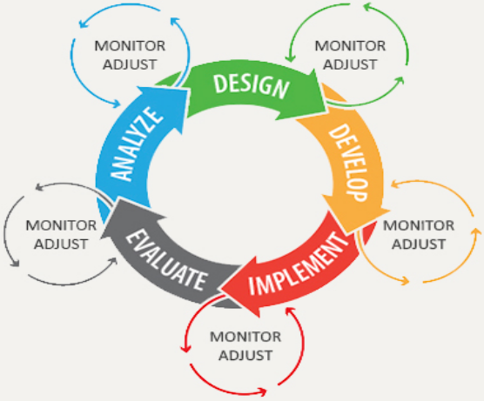
Unit 12.1 - Program Development Life Cycle
Prepared by: Koh Kian Hua

Slide 2
Objectives
After completing this unit, students should be able to:
Show understanding of the purpose of a development life cycle.
Show understanding of the need for different development life cycles depending on the program being developed including, waterfall, iterative, rapid application development (RAD).
Describe the principles, benefits and drawbacks of each type of life cycle.
Show understanding of the analysis, design, coding, testing and maintenance stages in the program development life cycle.

Slide 3
Program Development Life Cycle
What is Program Development Life Cycle
Program Development Life Cycle (PDLC) is a systematic way of developing quality software.
It provides an organized plan for breaking down the task of program development into manageable parts.
Each part must be successfully completed before moving on to the next phase.

Slide 4
Program Development Life Cycle
Stages of Program Development Life Cycle (PDLC)
The PDLC contains the five phases of program development:
Analyzing,
Designing,
Coding,
Debugging and testing,
Implementing and maintaining application software.

Slide 5
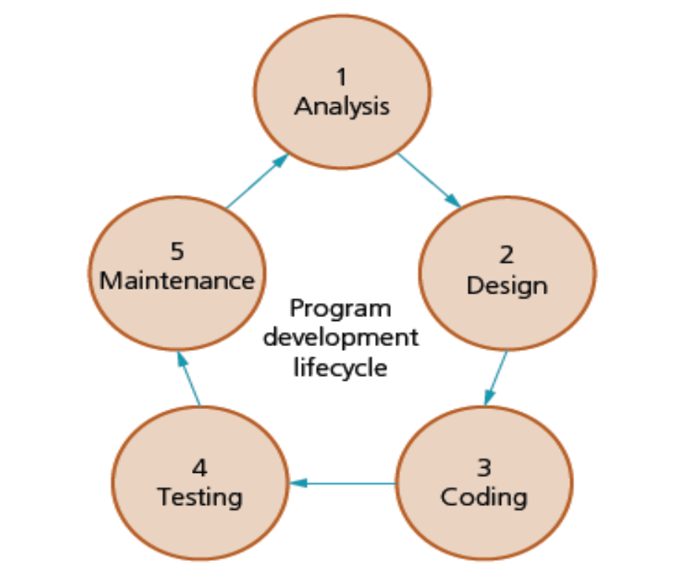
Program Development Life Cycle
Stages of Program Development Life Cycle (PDLC)
Figure showing the five phases of program development life cycle

Slide 6
Program Development Life Cycle
First Phase of PDLC : Analysis
Analyze the problem: The computer user must figure out the problem, then decide how to resolve the problem. This is called the requirements specification.
The analysis stage often starts with a feasibility study, followed by investigation and fact finding to identify exactly what is required from the program.

Slide 7
Program Development Life Cycle
Second Phase of PDLC : Design
Design the program: The design stage is used to tell the programmer what needs to be done, how the tasks that need to be completed, how each task is to be performed and how the tasks work together.
This can be formally documented using structure charts, state-transition diagrams and pseudocode.
This provides a visual diagram of the flow containing the program. This step will help you break down the problem.

Slide 8
Program Development Life Cycle
Third Phase of PDLC : Coding
Coding: This is using the language of programming to write the lines of code.
The code is called the listing or the source code.
The computer user will run an object code for this step.

Slide 9
Program Development Life Cycle
Fouth Phase of PDLC : Testing
Testing: The program is run many times with different sets of test data.
The purpose of testing is to ensure that it does everything it is supposed to do in the way set out in the program design.
Testing also makes make sure there are no syntax and logic errors. Syntax are grammatical errors and logic errors are incorrect results.

Slide 10
Program Development Life Cycle
Fifth Phase of PDLC : Maintenance
Maintenance: The program is maintained throughout its life, to ensure it continues to work effectively.
This involves dealing with any problems that arise during use, including correcting any errors.
It also involves improving the functionality of the program, or adapting the program to meet new requirements.

Slide 11
Program Development Life Cycle
Types of Program (Software) Development Model
Each program development methodology has its own strength.
Different models are developed based on the lifecycle for developers to use in practice.
The different models can will be divided into the five stages: analysis, design, coding, testing and maintenance.
There are three popular models of program development methodology. These are:
  the waterfall model
  the iterative model
  rapid application development (RAD).

Slide 12
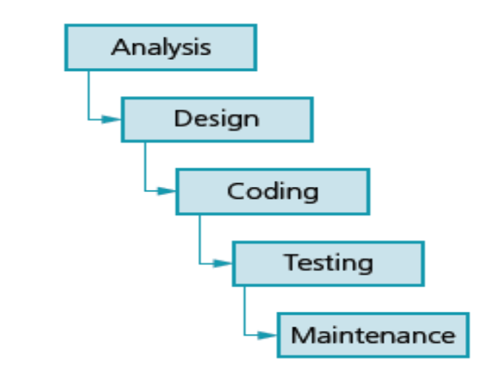
Program Development Life Cycle
The Waterfall Model
This linear sequential development cycle is one of the earliest models used.
Each stage is completed and signed off before the next stage is begun.
This model is suitable for smaller projects with a short timescale, for which the requirements are well known and unlikely to change.
Figure showing the waterfall model

Slide 13
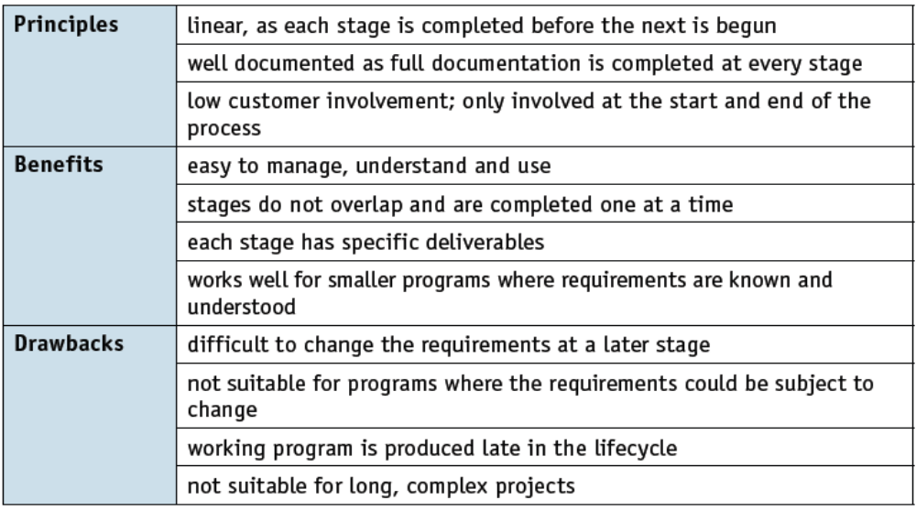
Program Development Life Cycle
The Waterfall Model
The table below shows the principles, benefits and drawbacks to the waterfall model.

Slide 14
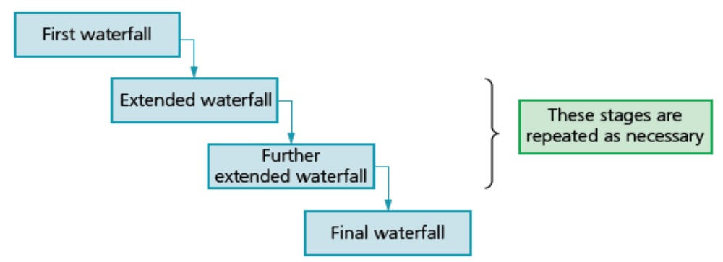
Program Development Life Cycle
The Iterative Model
This development cycle first develops a simple subset of the requirements.
It then expands or enhances the model and runs the development cycle again.
These program development cycles are repeated until the full system has been developed.
This model is suitable for projects for which the major requirements are known but some details are likely to change or evolve with time.
Figure showing the Iterative Model

Slide 15
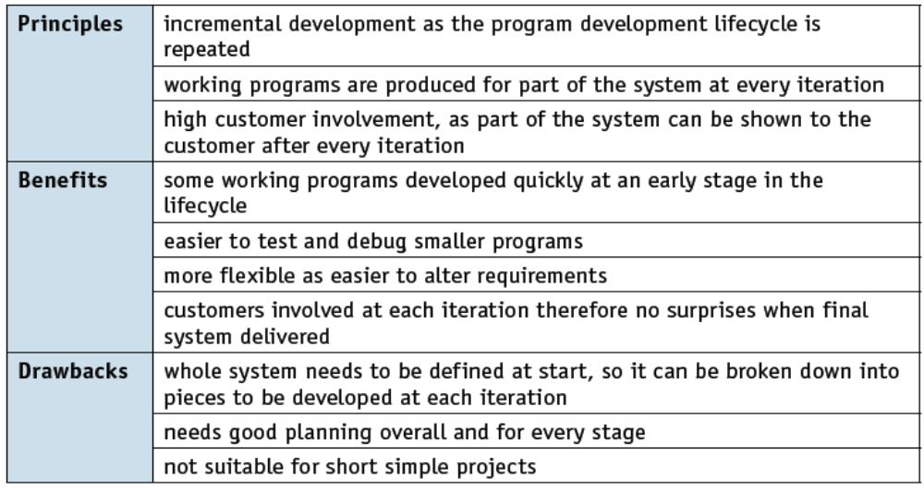
Program Development Life Cycle
The Iterative Model
The table below shows the principles, benefits and drawbacks to the iterative model.

Slide 16
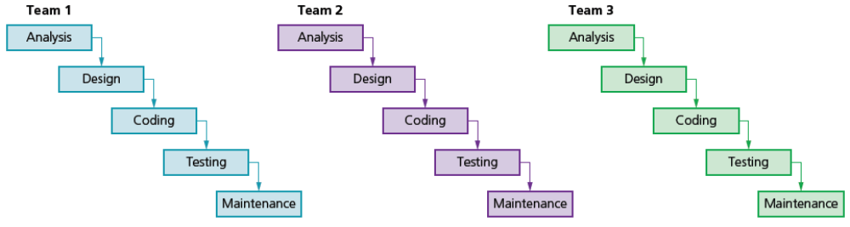
Program Development Life Cycle
Rapid Application Development (RAD)
Program development cycles are run in parallel for each part of the requirement, using a number of different teams.
Prototyping is often used to show initial versions to customers to obtain early feedback.
This model is suitable for complicated projects that need developing in a short timeframe to meet the evolving needs of a business.
Figure of RAD Model

Slide 17
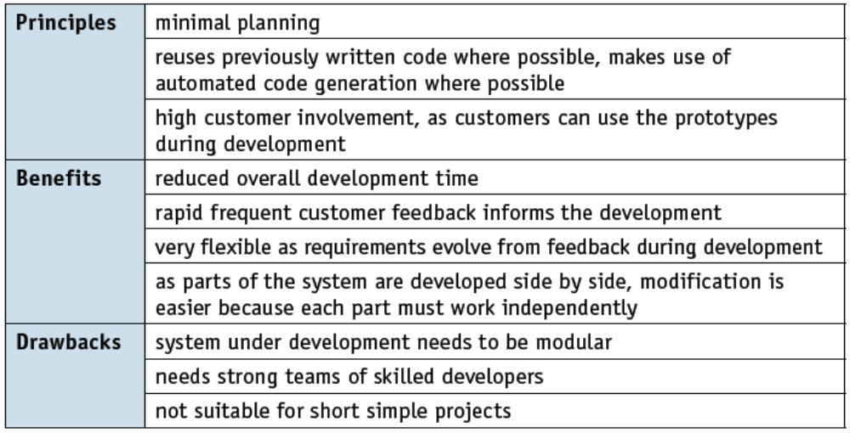
Program Development Life Cycle
Rapid Application Development (RAD)
The table below shows the principles, benefits and drawbacks to the iterative model.

Slide 18
Program Development Life Cycle
Class Activity
The table below shows the principles, benefits and drawbacks to the iterative model.

Slide 19
Program Development Life Cycle
Class Activity
1) Define what is Program (Software) Development Life Cycle
2) Descrribe the five stages of the program development life cycle

